Slide 1
Исправљачи
Са диодама

Slide 2
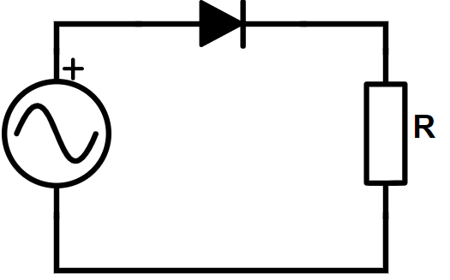
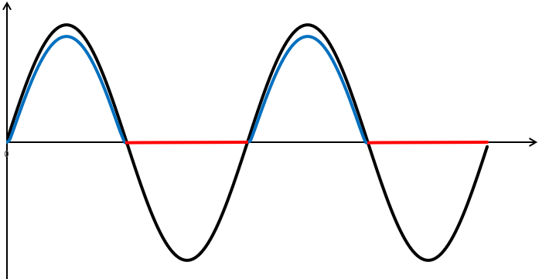








$$e(t)$$
$$u_{r}(t)$$
$$i$$
$$e(t)$$
$$u_{r}(t)$$
$$e(t)$$
$$u_{r}(t)$$
$$t$$

Slide 3
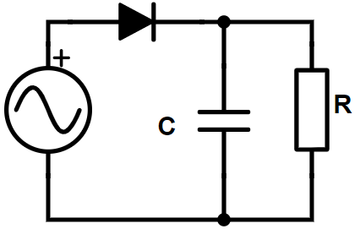
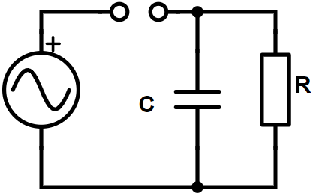
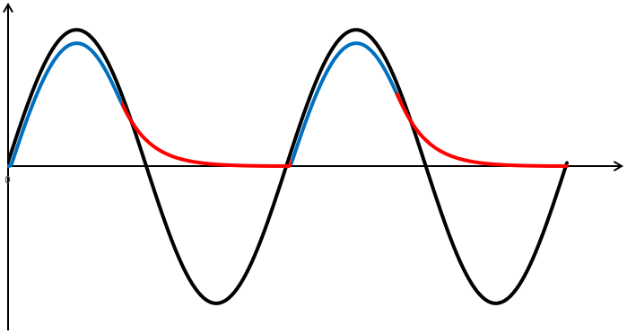
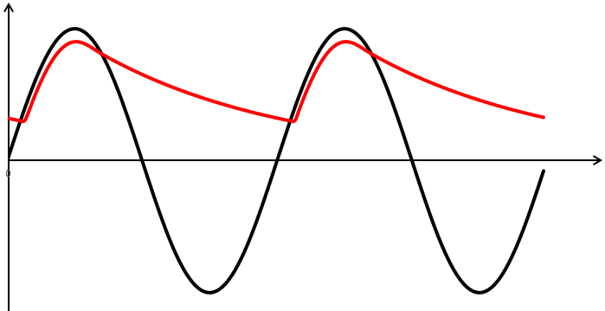











$$i$$
$$e(t)$$
+
+
-
$$u_{r}(t)$$
-
$$e(t)$$
$$u_{r}(t)$$
$$e(t)$$
$$e(t)$$
$$u_{r}(t)$$
$$u_{r}(t)$$
$$t$$
$$t$$

Slide 4
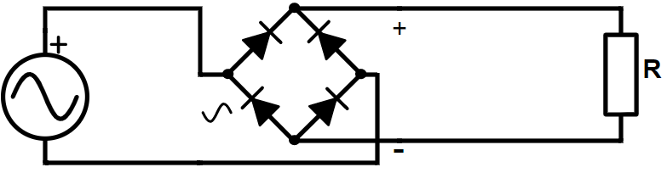
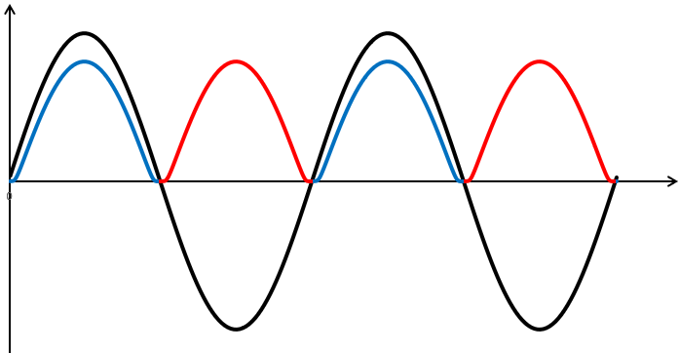






Грецов спој
$$i$$
$$e(t)$$
$$u_{r}(t)$$
$$e(t)$$
$$u_{r}(t)$$
$$t$$

Slide 5
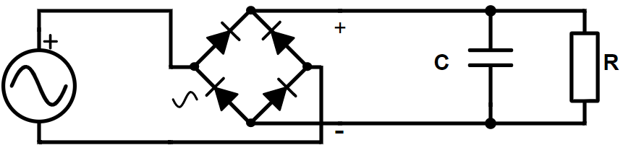
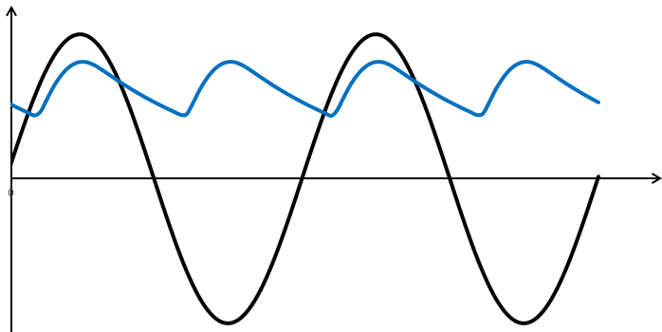





Грецов спој
Додат кондензатор
$$e(t)$$
$$u_{r}(t)$$
$$e(t)$$
$$u_{r}(t)$$
$$t$$

