Slide 1
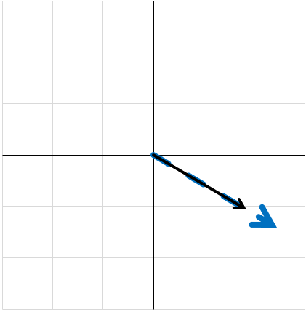
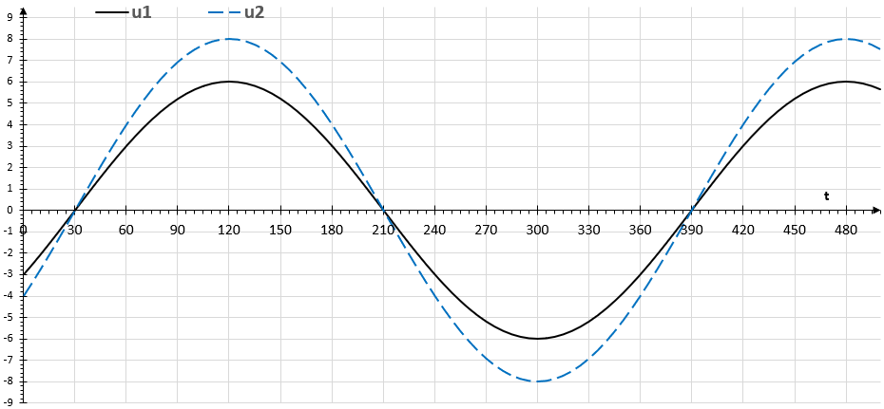
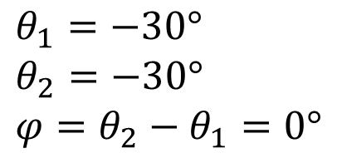

$$θ_{1}=−30° \\ θ_{2}=−30° \\ φ=θ_{2}−θ_{1}=0°$$
$$30°$$

Slide 2
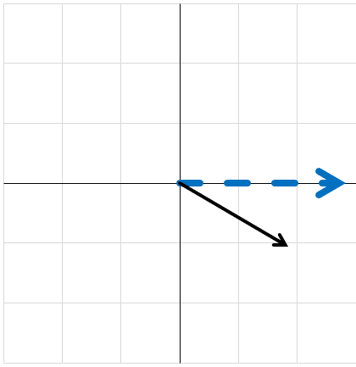
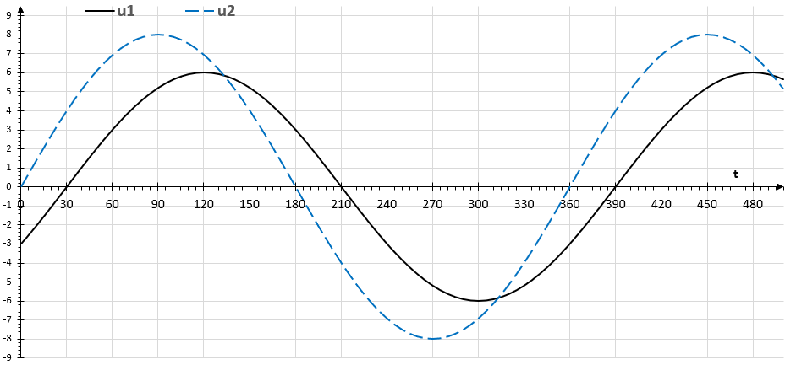
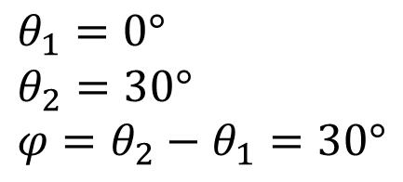

$$θ_{1}=0° \\ θ_{2}=30° \\ φ=θ_{2}−θ_{1}=30°$$
$$−30°$$

Slide 3
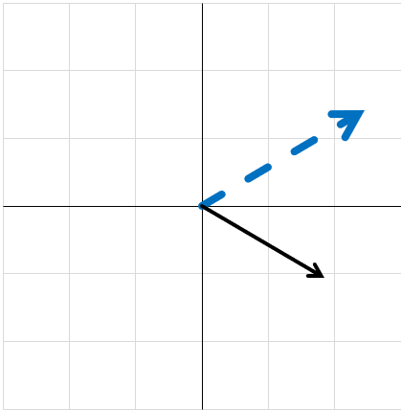
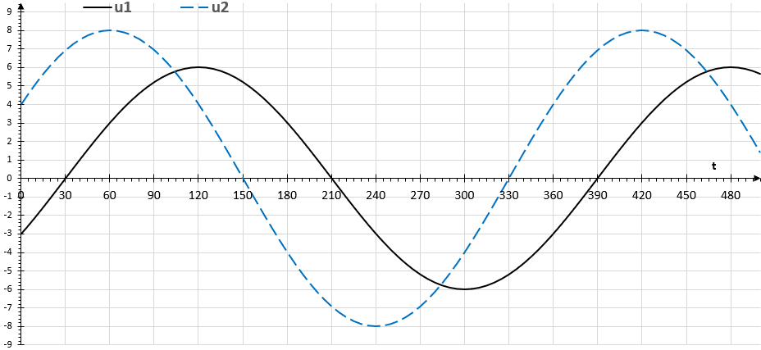
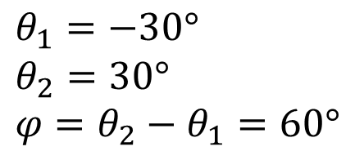


$$θ_{1}=−30° \\ θ_{2}=30° \\ φ=θ_{2}−θ_{1}=60°$$
$$30°$$
$$60°$$
$$−30°$$

Slide 4
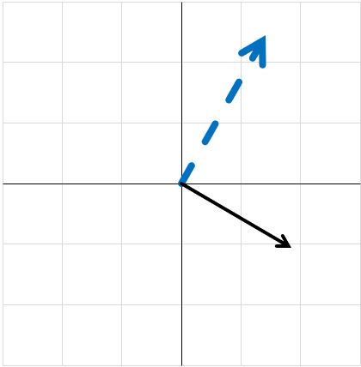
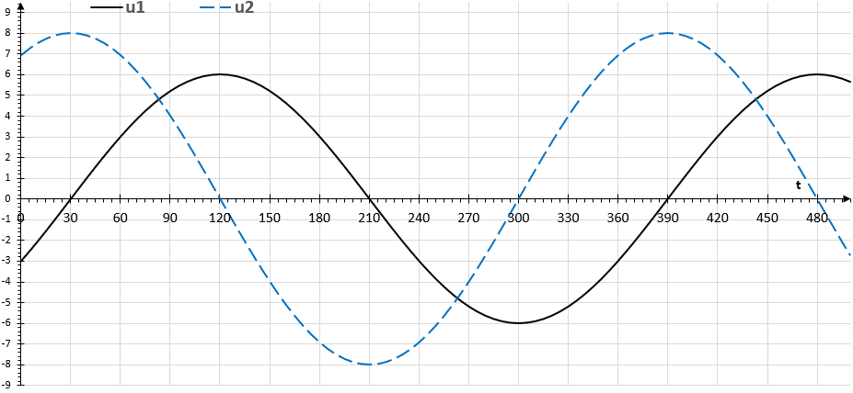
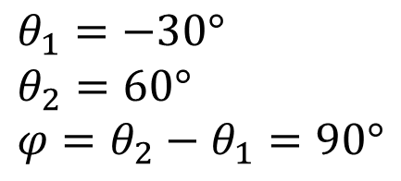



$$θ_{1}=−30° \\ θ_{2}=60° \\ φ=θ_{2}−θ_{1}=90°$$
$$60°$$
$$90°$$
$$−30°$$

Slide 5
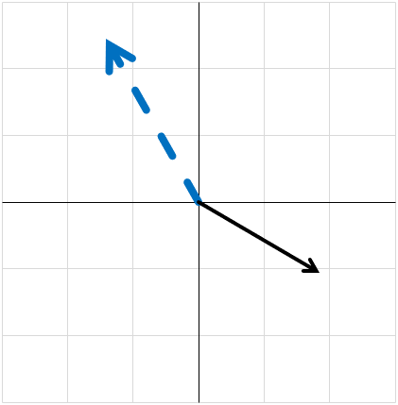
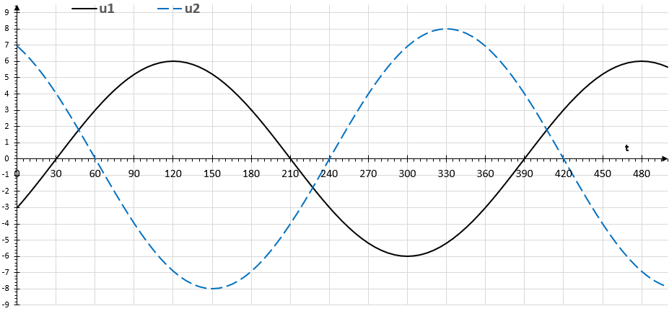
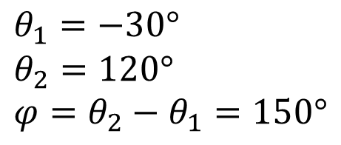



$$θ_{1}=−30° \\ θ_{2}=120° \\ φ=θ_{2}−θ_{1}=150°$$
$$150°$$
$$120°$$
$$−30°$$

Slide 6
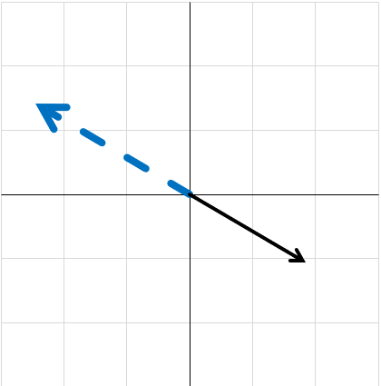
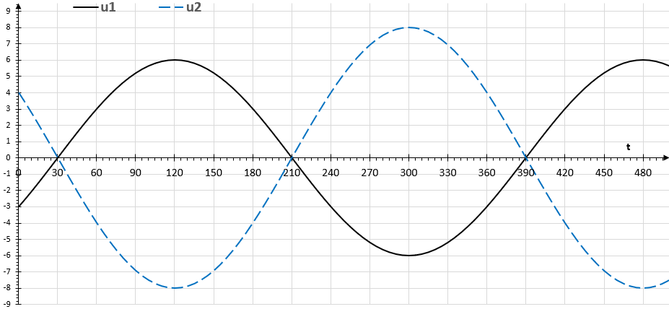
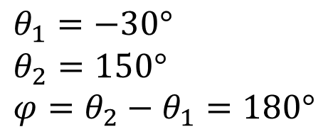


$$θ_{1}=−30° \\ θ_{2}=150° \\ φ=θ_{2}−θ_{1}=180°$$
$$180°$$
$$150°$$
$$−30°$$

Slide 7
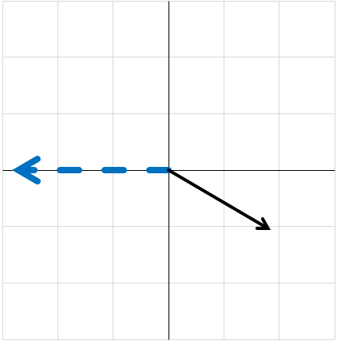
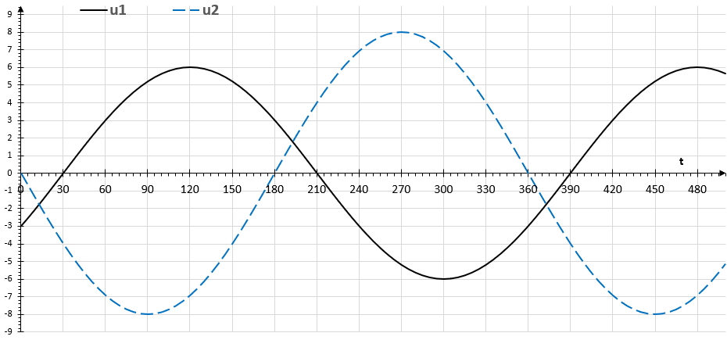

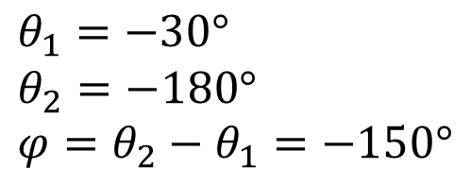

$$θ_{1}=−30° \\ θ_{2}=−180° \\ φ=θ_{2}−θ_{1}=−150°$$
$$−30°$$
$$−180°$$
$$−150°$$

Slide 8
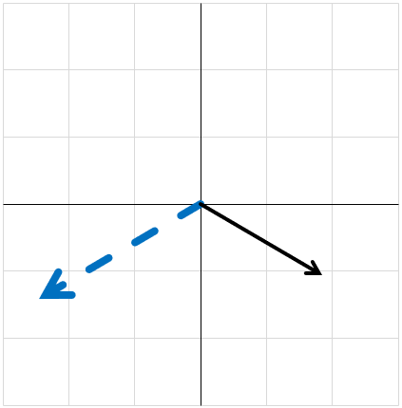
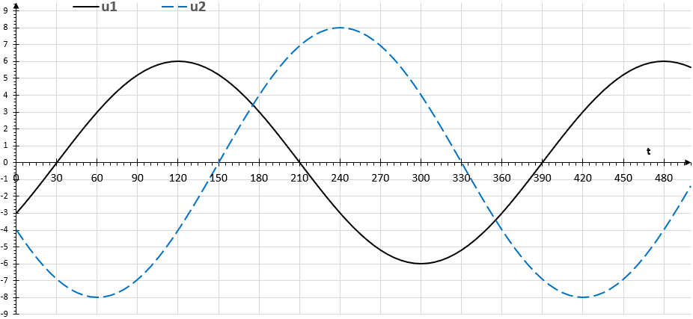


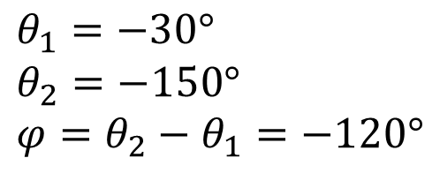
$$θ_{1}=−30° \\ θ_{2}=−150° \\ φ=θ_{2}−θ_{1}=−120°$$
$$−30°$$
$$−150°$$
$$−120°$$

Slide 9
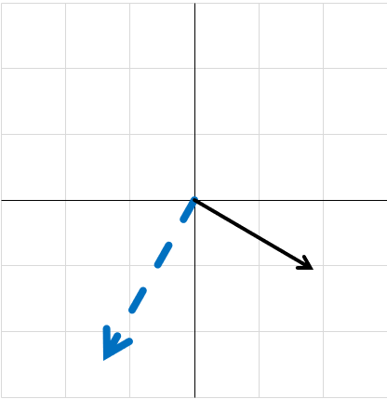
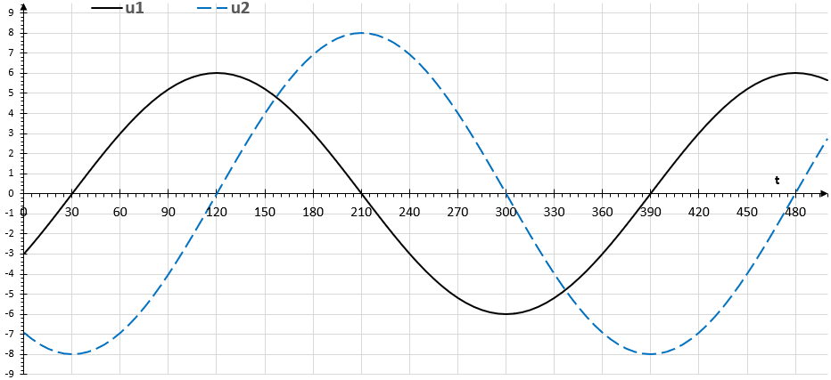
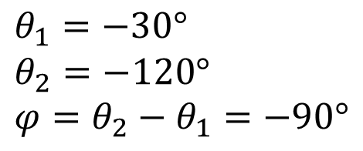


$$θ_{1}=−30° \\ θ_{2}=−120° \\ φ=θ_{2}−θ_{1}=−90°$$
$$−30°$$
$$−120°$$
$$−90°$$

Slide 10
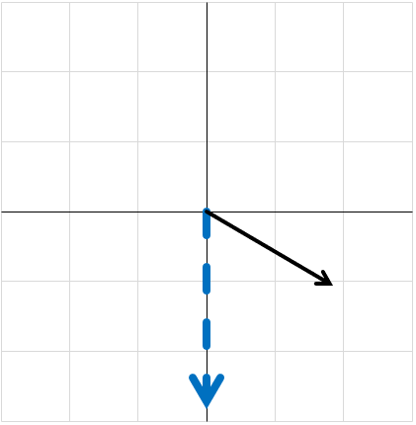
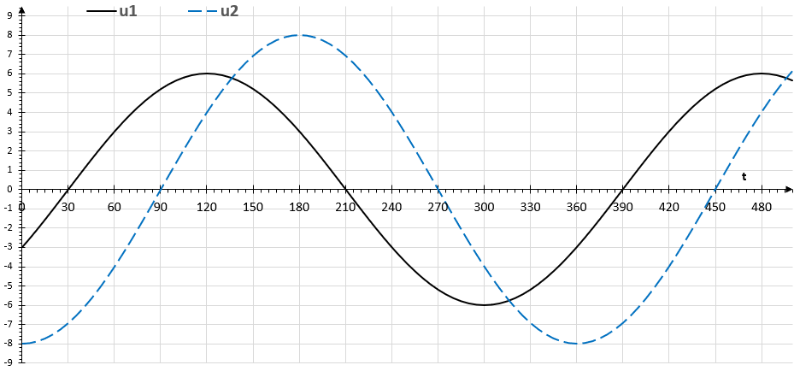
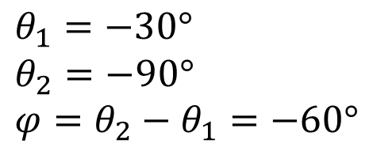


$$θ_{1}=−30° \\ θ_{2}=−90° \\ φ=θ_{2}−θ_{1}=−60°$$
$$−30°$$
$$−90°$$
$$−60°$$

Slide 11
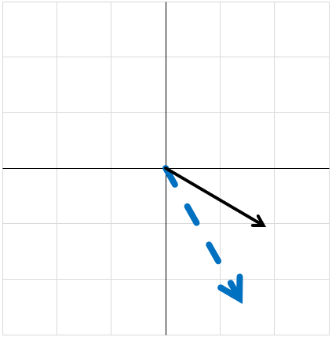
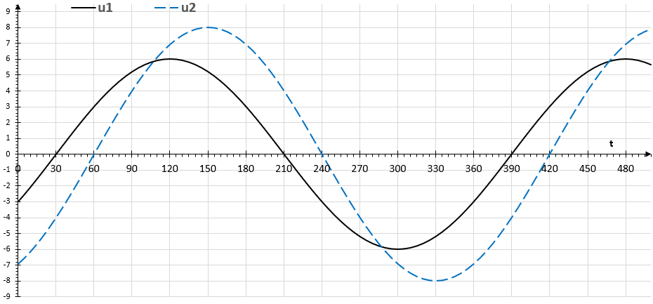
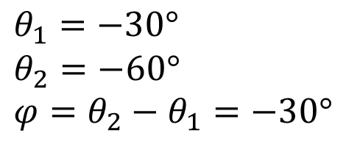


$$θ_{1}=−30° \\ θ_{2}=−60° \\ φ=θ_{2}−θ_{1}=−30°$$
$$−30°$$
$$−60°$$
$$−30°$$

Slide 12
$$θ_{1}=−30° \\ θ_{2}=−30° \\ φ=θ_{2}−θ_{1}=0°$$
$$30°$$

